Slide 1
Lightweight CNN Image Classifier with On-chip Preprocessing
Group 2
B06901178 蔡易霖 R10943005 楊宗賢 R10943118 林宥陞

Slide 2
Outline
Problem Statement
System Overview
Low Bit Width 1-Channel CNN Model
Training and Evaluation
Memory Style Adjustment
PYNQ Composable Pipeline
Xilinx Partial Reconfiguration / Dynamic Function eXchange

Slide 3
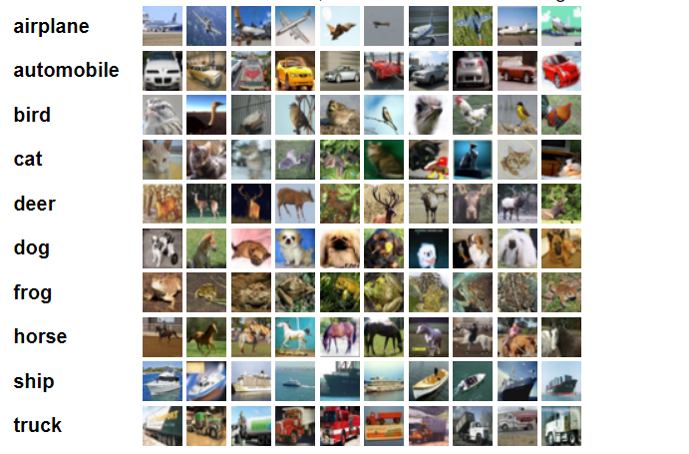
Application Field
In IoT or embedded system, certain tasks require an image sensor with a classification function that can apply the solution we have provided.

Slide 4
Issues
In traditional object recognition, the camera receives three color channels and then sends all of them to the Convolutional Neural Network (CNN) for classification.
However, in specific scenarios, only the shape but not the hue of the object matters, because both the object and the background may have a variety of colors.
Hence, the preprocessing to merge channels together can significantly save both the hardware resources and the computation latency.
Although the preprocessing steps (e.g. RGB to Grayscale or RGB to Brightness) are not a burden even for the processors, the additional PS-PL transmission cost may degrade the benefit obtained from preprocessing.
By building a purely PL-side image classification pipeline, the performance would be possibly further improved and then be suitable for real-time applications.

Slide 5
Objective
We would like to integrate the customized VGG-5 CNN network generated by FINN with the ready-to-use color conversion functions in PYNQ Composable Pipeline.
The finished system will:
Convert the received colored input images from the CIFAR-10 dataset to either Grayscale or Brightness
Classify the preprocessed one-channel image into the correct class.

Slide 6
Target Specification
We aim to reduce the complexity of the CNN IP by merging three channels of the input image, without a large impact on the classification accuracy.
The accuracy may be slightly degraded.
The resource utilization is expected to be reduced.
The throughput and latency would be elevated compared to PS-side preprocessing.
All the computations are in dataflow.

Slide 7
Outline
Problem Statement
System Overview
Low Bit Width 1-Channel CNN Model
Training and Evaluation
Memory Style Adjustment
PYNQ Composable Pipeline
Xilinx Partial Reconfiguration / Dynamic Function eXchange

Slide 8
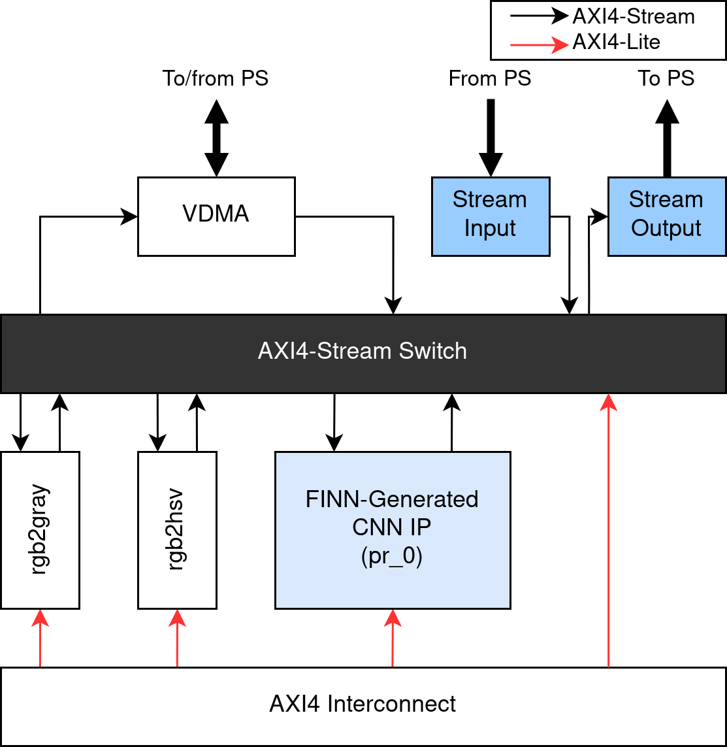
System Block Diagram
We simplified the Composable Pipeline by removing:
Unused static functions
Unused reconfigurable partitions
HDMI I/O ports
Then, we appended:
FINN-generated CNN model in RP
Another DMA IP for PS-PL AXI4-Stream transfer

Slide 9
Outline
Problem Statement
System Overview
Low Bit Width 1-Channel CNN Model
Training and Evaluation
Memory Style Adjustment
PYNQ Composable Pipeline
Xilinx Partial Reconfiguration / Dynamic Function eXchange

Slide 10
Training setting
We have tried different optimizers for low bit width training, but Adam seem to be the best selection either in terms of accuracy or convergence
ADAM with larger batch size and learning rate can find a more general solution which can reduce overfitting
Optimizer: ADAM
Batch size: 200
learning rate: 0.2
Epochs: 1000
Random brightness to the training data set
Reference: https://medium.com/mini-distill/effect-of-batch-size-on-training-dynamics-21c14f7a716e

Slide 11
Model Base-line
Training Dataset: cifar-10
Model: VGG9-1w1a, with gray input image
Seven convolution layers and two fully connected layers
Accuracy: 80.91%
Parameter:
Fully connection: 34048
Convolution: 1732800
Layer | CNV 1 | CNV 2 | CNV 3 | CNV 4 | CNV 5 | CNV 6 | CNV 7 | FC 1 | FC 2
parameter | 192 | 36864 | 73728 | 147456 | 294912 | 589824 | 589824 | 32768 | 1280

Slide 12
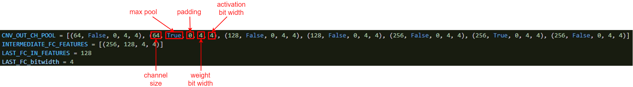
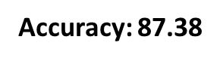
Adjust The Bit width
The goal is to achieve 85% accuracy
Concept: Use more bit width to improve accuracy
How to decide the bit width of each layer ?
Synchronously increase the bit width of each layer
For example: set 4 bits for both weight and activation

Slide 13
Adjust The Bit width
It does efficiently improve accuracy from 80.91% to 87.38%
Is there any chance to further reduce model size but remain the same accuracy ?
Make a try
Increase the bit width of front-end layer
Increase the bit width of back-end layer
Staggered increase the bit width of each layer
Increase the bit width of input and output layer

Slide 14
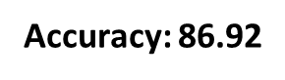
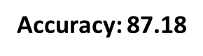
Adjust The Bit width
Increase the weight bit width of front-end layer
Increase the weight bit width of back-end layer

Slide 15


Adjust The Bit width
Staggered increase weight the bit width of each layer
Increase the weight bit width of input and output layer

Slide 16
Adjust The Bit width
As we can see, the configuration “staggered increase the bit width of each layer” and “increase the bit width of input and output layer” are better than the other
It is worth noting that these two version are more accurate than the VGG -9-4w4a
 | Origin(1w1a) | VGG-9-4w4a | Front | Back | Staggered | Input and Output
Accuracy(%) | 80.91 | 87.38 | 86.92 | 87.17 | 87.59 | 87.75

Slide 17
Adjust The Bit width
According to the previous description, if the bit width of the hidden layer is further reduced, will the accuracy be maintained?
Accuracy: 87.07
About a 0.7% drop in accuracy

Slide 18
Adjust The Bit width
Staggered increase the activation bit width of each layer
Accuracy: 86.87
Increase the activation bit width of input and output layer
Accuracy: 87.23
The effect of weight is better, because weight is trainable

Slide 19
Tool specific issue
In this version of FINN, we encounter a problem during the model transform
The problem is that the activation of the last convolution layer must be one bit width, if there are other values that the transform will fall
In this case we increase the activation of the last convolution layer to compensate the accuracy decrease

Slide 20
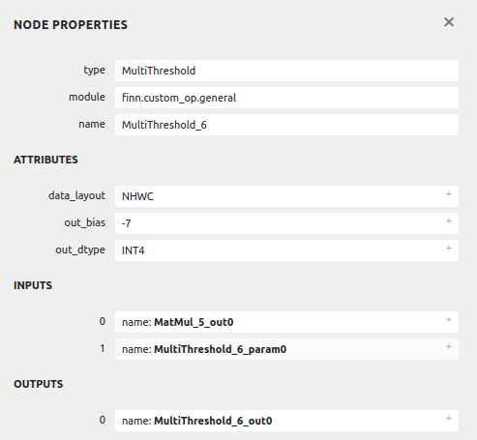
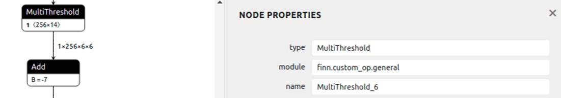
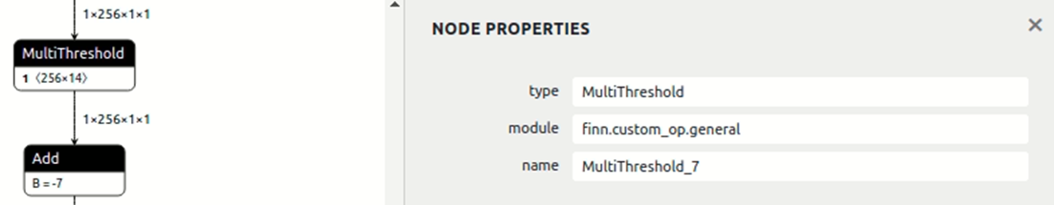
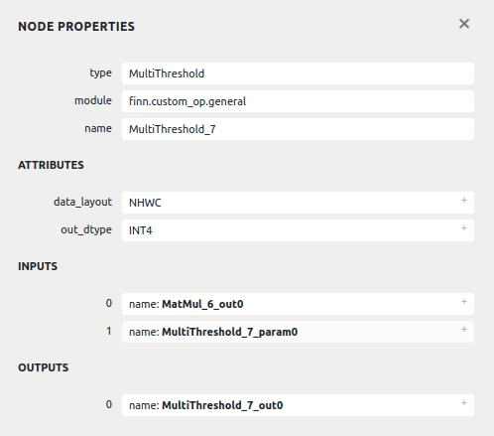
Tool specific issue
transform
transform

Slide 21
Limited Resource
This model was originally generated by finn, but must be integrated into the composable pipeline
So that the resource is more limited
 | VGG-9-in-out | Xilinx Zynq-7020
LUT Logic | 67608 | 53200
LUT Memory | 14364 | 17400
Registers | 98268 | 106400
BRAM (RAMB36) | 219 | 140

Slide 22
Reduce Layer
The parameter in the neural network come from two part, convolution layer and fully connected layer
In the origin model VGG9-in-out, the parameter of last convolution layer dominate the whole model
Actually on previous paper have shown that fully connected layer is not the critical layer of image classification

Slide 23
Reduce Layer
We have tested various types of layer configuration that achieve the best accuracy when hardware is available
Here we reduce the fully connected layer into one layer, and reduce the convolution layers into four layers

Slide 24
1-Channel VGG-5-w4a4 CNN Model
 | Input |  | Kernel |  |  |  | Output
 | Shape | Channels | Shape | Padding | Stride | Weight Bit Width | Shape | Channels
conv3-64 | 32x32 | 1 | 3x3 | 1 | 1 | 4 bits | 32x32 | 64
maxpool-2 | 32x32 | 64 |  |  |  |  | 16x16 | 64
conv3-96 | 16x16 | 64 | 3x3 | 1 | 1 | 3 bits | 16x16 | 96
maxpool-2 | 16x16 | 96 |  |  |  |  | 8x8 | 96
conv3-128 | 8x8 | 96 | 3x3 | 0 | 1 | 3 bits | 6x6 | 128
maxpool-2 | 6x6 | 128 |  |  |  |  | 3x3 | 128
conv3-192 | 3x3 | 128 | 3x3 | 0 | 1 | 4 bits | 1x1 | 192
FC-10 | 1x1 | 192 | 1x1 | 0 | 1 | 3 bits | 1x1 | 10
Accuracy: 85.05
Achieving more than 85% accuracy !

Slide 25
Verify
With this simple example we can see that our observation is correct
Accuracy: 85.05
Accuracy: 85.15
Accuracy just reduced 0.1% when decrease the bit width on middle layer

Slide 26
Parameter comparison
 |  | VGG-9-w1a1 | VGG-9-w4a4 | VGG-9-in-out | VGG-5
Parameter | 1 bit | 1,766,848
 | 2 bit |  |  | 516,096
 | 3 bit |  |  | 1,250,752 | 167,808
 | 4 bit |  | 1,766,848 |  | 221,760
Accuracy(%) |  | 80.91 | 87.38 | 87.75 | 85.05

Slide 27
Memory Style Adjustment of Each Layer
The ram_style parameter decides whether BRAM or LUTRAM is used to store weights.
 | PE | SIMD | Weight Bit Width | Weight Numbers | ram_style | BRAM | LUTRAM
conv3-64 | 8 | 1 | 4 bits | 576 | auto | 0.5 | 0
maxpool-2 |  |  |  |  |  | 0.0 | 256
conv3-96 | 8 | 16 | 3 bits | 55296 | distributed | 0.0 | 3584
maxpool-2 |  |  |  |  |  | 0.0 | 288
conv3-128 | 4 | 16 | 3 bits | 110592 | auto | 11.0 | 0
maxpool-2 |  |  |  |  |  | 0.0 | 0
conv3-192 | 1 | 16 | 4 bits | 221184 | auto | 32.0 | 0
FC-10 | 5 | 1 | 3 bits | 1920 | distributed | 0.0 | 132

Slide 28
Resource Utilization Comparison
0.36x of total BRAM usage less than VGG-9-w1a1, and 4.14% improvement of accuracy
0.13x ~ 0.39x of resource usage less than VGG-9-w4a4, and only 2.33% lower accuracy
 | VGG-9-w1a1 | VGG-9-w4a4 | VGG-5-w4a4 | VGG-5 | Xilinx Zynq Z-7020
LUT Logic | 21993 | 125537 | 26956 | 23144 | 53200
LUT Memory | 1464 | 14152 | 6458 | 5572 | 17400
Registers | 35242 | 136286 | 47946 | 40509 | 106400
BRAM (RAMB36) | 121 | 322 | 45.5 | 44 | 140
ACC(%) | 80.91 | 87.38 | 85.15 | 85.05

Slide 29
Low Bit Width Training Summary
Using more bit width of the input layer and the output layer is more effective
Using a fully connected layer is enough and low bit width is acceptable
ADAM optimizer with large batch size and learning rate can get good results

Slide 30
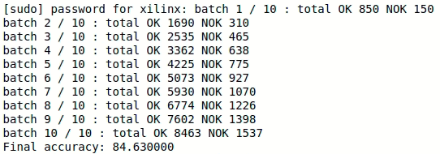
Validation on Board
84.63%, slightly higher than VGG-9-w1a1

Slide 31
Outline
Problem Statement
System Overview
Low Bit Width 1-Channel CNN Model
Training and Evaluation
Memory Style Adjustment
PYNQ Composable Pipeline
Xilinx Partial Reconfiguration / Dynamic Function eXchange

Slide 32
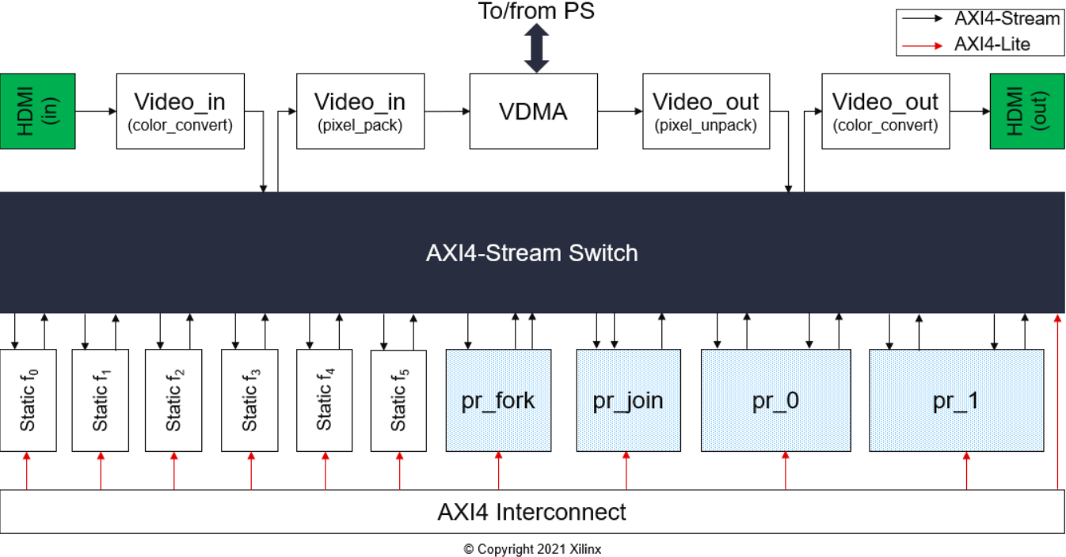
PYNQ Composable Pipeline
Consist of 6 static functions, 4 reconfigurable regions, and 2 HDMI port interfaces
Synthesized with Vivado 2020.2
Python API is provided

Slide 33
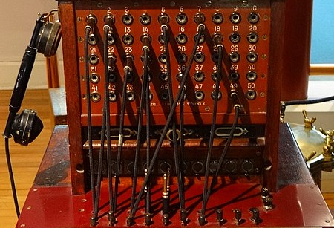
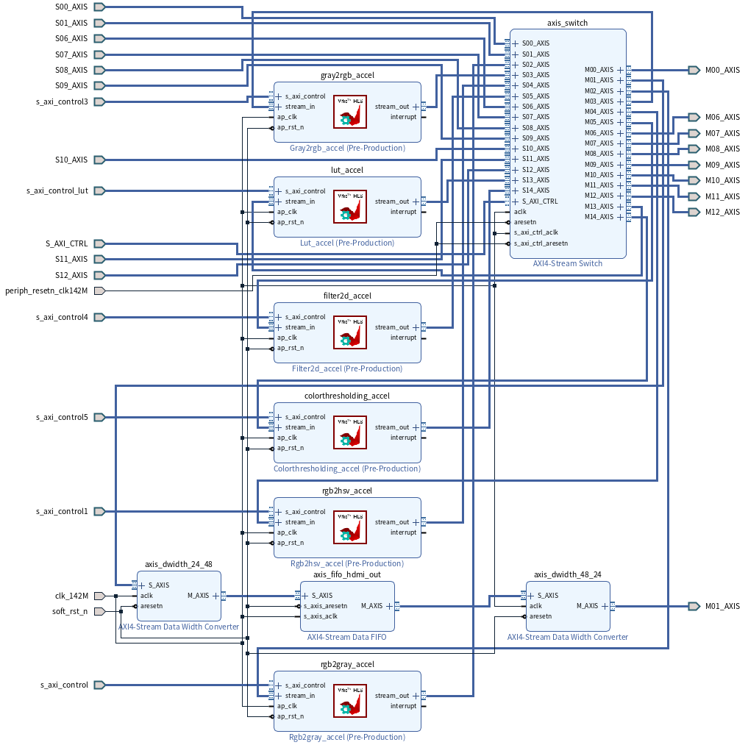
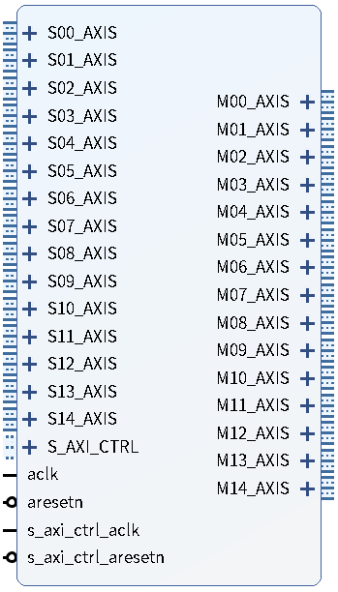
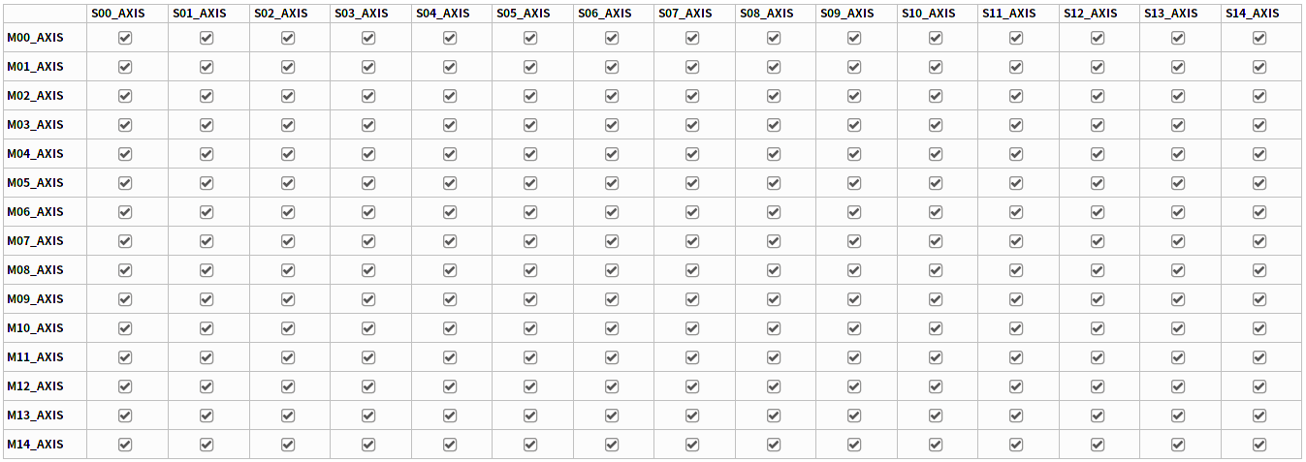
AXI4-Stream Switch IP
https://commons.wikimedia.org/wiki/File:Sewell_Museum_Telephone_switchboard_(2).jpg
15 consumers (slave interfaces)
15 producers (master interfaces)
Full Connectivity
Configure through AXI4-Lite

Slide 34
Static Functions
Come from Vitis Vision Library:
rgb2gray
rgb2hsv
lut
gray2rgb
filter2d
colorthresholding

Slide 35
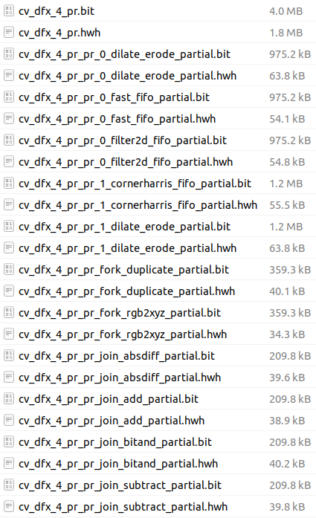
Reconfigurable Functions
Download the partial bitstream to switch between the available functions
4 regions can be reconfigured separately at the same time
pr_0 | dilate_erode | fast_fifo | filter2d_fifo
pr_1 | dilate_erode | cornerharris_fifo
pr_fork | duplicate | rgb2xyz
pr_join | substract | absdiff | add | bitand

Slide 36
Outline
Problem Statement
System Overview
Low Bit Width 1-Channel CNN Model
Training and Evaluation
Memory Style Adjustment
PYNQ Composable Pipeline
Xilinx Partial Reconfiguration / Dynamic Function eXchange

Slide 37
Partial programming
Partial programming allows the modification of an operating FPGA design by loading a partial BIT file
After a full BIT file configures the FPGA, partial BIT files can be downloaded to modify reconfigurable regions in the FPGA
It does not compromise the integrity of the applications running on those parts of the device that are not being reconfigured

Slide 38
Addressing configuration overhead
Configuration overhead is a major performance bottleneck for partial programming
Two methods in this paper to address configuration overhead
Designing and implementing fully streaming DMA engines to saturate the configuration throughput.
Fully streaming DMA engines reduce the configuration time from the range of seconds to the range of milliseconds
Exploiting a simple form of data redundancy to compress the configuration bitstreams, and implement an intelligent internal configuration access port controller to perform decompression at runtime.
The proposed compression scheme achieves up to a 75% reduction in bitstream size and results in a decompression circuit with negligible hardware overhead

Slide 39
Energy efficiency
In conventional cases, there are a number of independent circuits within a hardware design, and some can be idle for long periods of time
Idle circuits still consume power though, especially through clock oscillation and static leakage
Using partial programming, one can replace these circuits during their idle time with others that consume much less power static leakage
Since the reconfiguration process itself introduces energy overhead, an experiment is needed to confirm if this approach actually leads to an overall energy saving or to a loss

Slide 40
Experimental results
Partial reconfiguration reduces the total energy consumption with using the approaches mentioned earlier to reduce configuration overhead
The paper applied these techniques to an existing embedded microprocessor design
Partial reconfiguration is compared against clock gating to evaluate its effectiveness

Slide 41
Commercial application of partial programming
PerceptIn demonstrate in their commercial product that runtime partial reconfiguration is useful for computing for autonomous vehicles
Because many on-vehicle tasks usually have multiple versions where each is used in a particular scenario
For instance, in PerceptIn’s design, the localization algorithm relies on two kinds of salient features
features in key frames are extracted by a feature extraction algorithm
features in non-key frames are tracked from previous frames
features in non-key frames executes 50% faster than features in key frames

Slide 42
Commercial application of partial programming
The conventional approach is not only area-inefficient, but also power-inefficient as the unused portion of the FPGA consumes non-trivial static power
PerceptIn develop a partial reconfiguration engine (PRE) that dynamically reconfigures part of the FPGA at runtime
The PRE achieves a 400 MB/sec reconfiguration throughput, and the reconfiguration delay is less than 1 ms

Slide 43
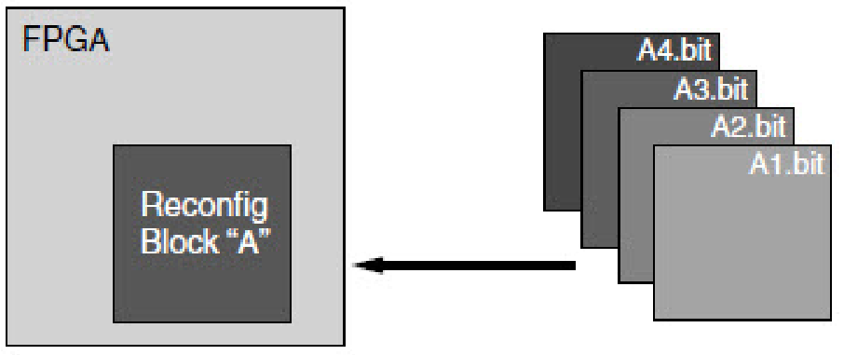
Xilinx Partial Reconfiguration
Partial Reconfiguration (PR) and Dynamic Function eXchange (DFX) are exchangeable terms.
After the full bitstream downloaded to the PL, the pregenerated partial bitstream can be still downloaded to the predefined reconfigurable regions during the runtime without breaking the functionality of the static region.

Slide 44

Xilinx DFX Design Flow
UG909 - Dynamic Function eXchange states there are two kinds of design flows that creates DFX:
Vivado Software Flow (Chapter 3) - through Tcl commands
Vivado Project Flow (Chapter 4) - through the GUI
Does not support Block Diagram instantiation before 2020.2
Block Design Container (BDC, Block Hierarchy) for DFX since 2021.1

Slide 45
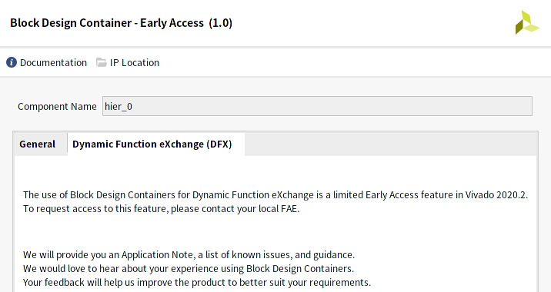
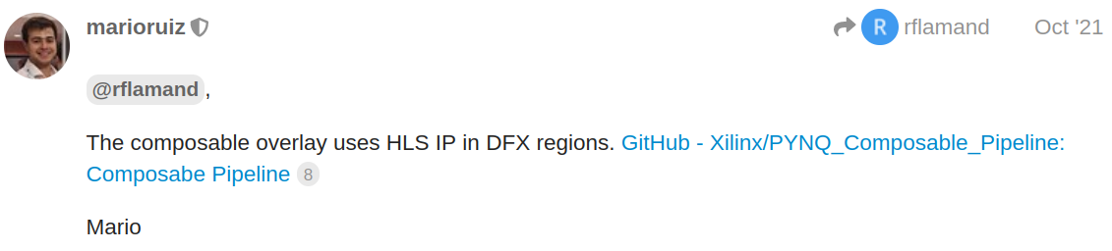
Xilinx DFX Design Flow
Sadly, BDC for DFX is limited Early Access in 2020.2, and we are unauthorized to enable it.
The author of Composable Pipeline mentioned that if we do not use BDC, we can follow his Tcl script approach to instantiate HLS IP in DFX.
We have to manually enter the commands into Tcl Console.

Slide 46
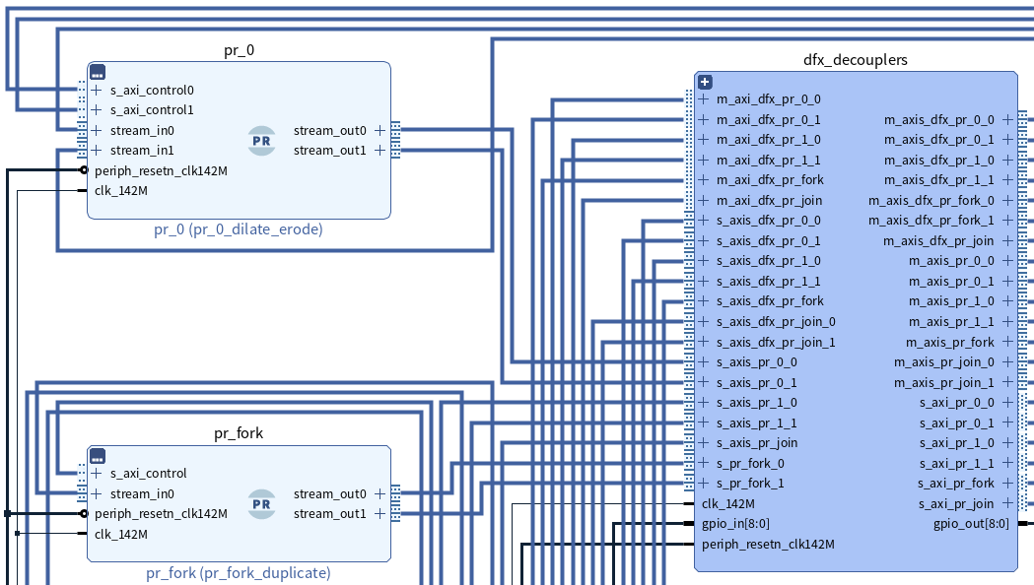
Reconfigurable Modules (RM)
Reconfigurable Partition (RP) is an attribute set on an instantiation that defines the instance as reconfigurable. The RP is the level of hierarchy within which different RMs are implemented.
Reconfigurable Module (RM) is the HDL description that is implemented within an RP. Multiple RMs exist for an RP.

Slide 47
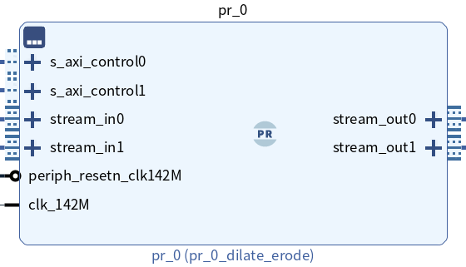
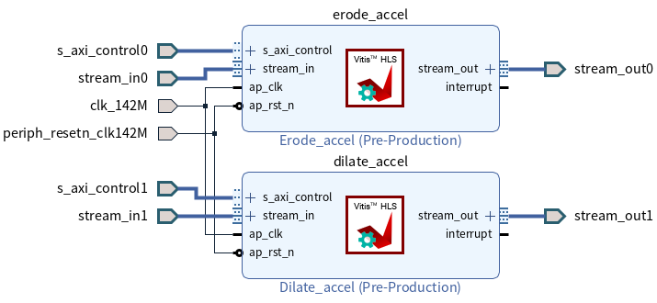
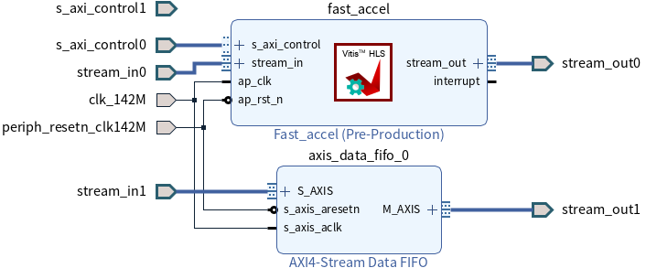
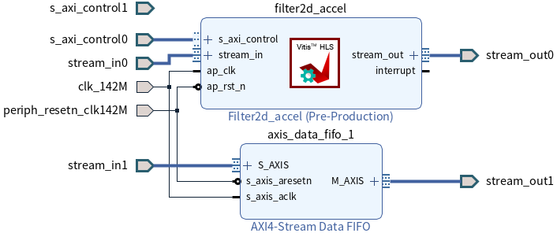
Partition Pins
All the RMs within an RP should have exactly the same pin definition between reconfigurable region and static region.
Manually drawing a Block Design as RM may result in port inconsistency of the generated RTL file. Vivado rejects implementation for such cases.
Even TLAST[0:0] and TLAST are regarded as different.

Slide 48
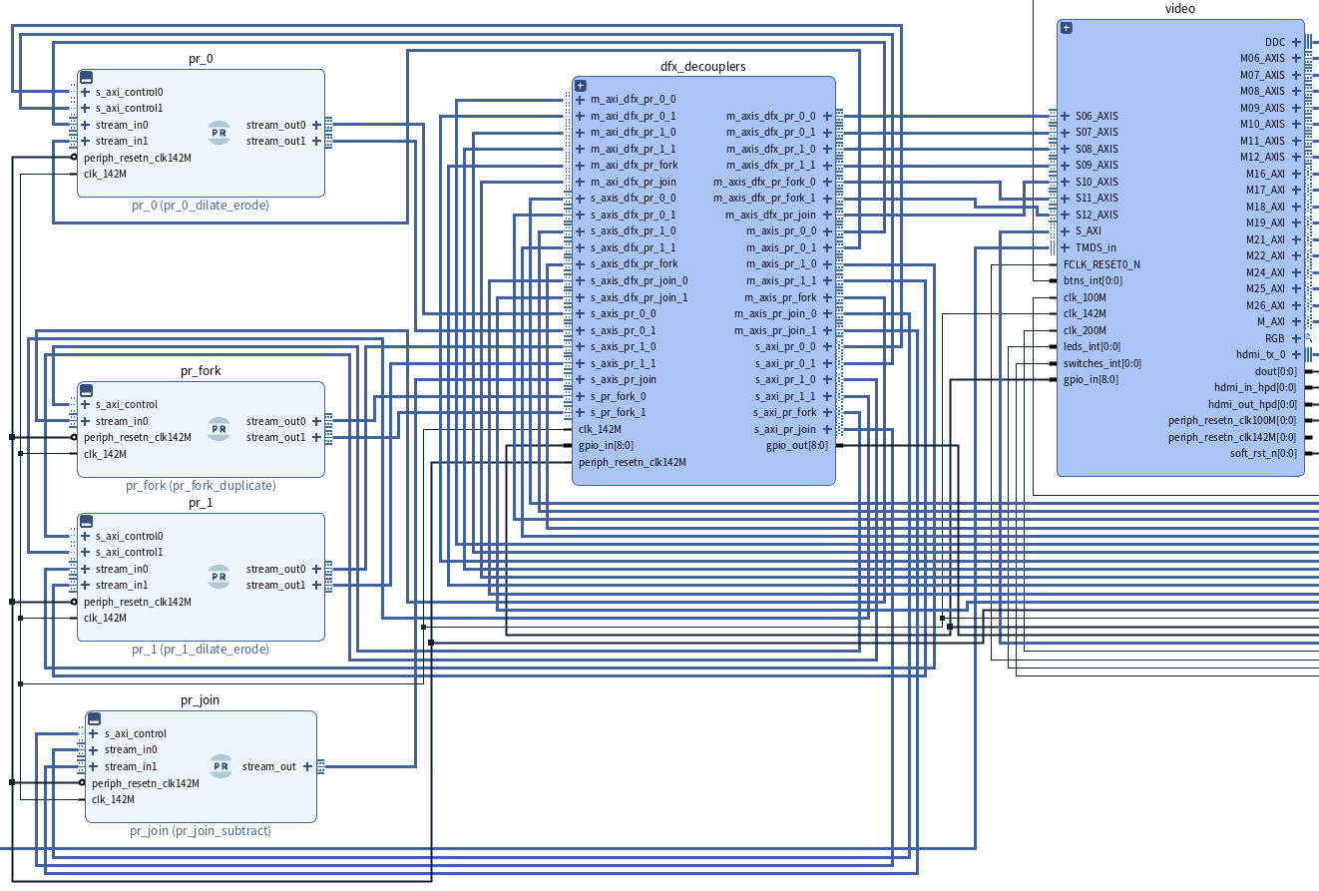
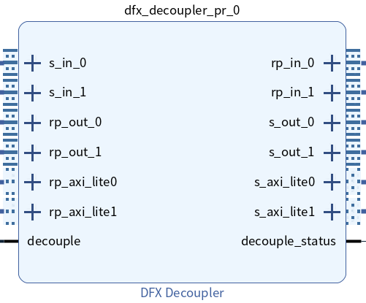
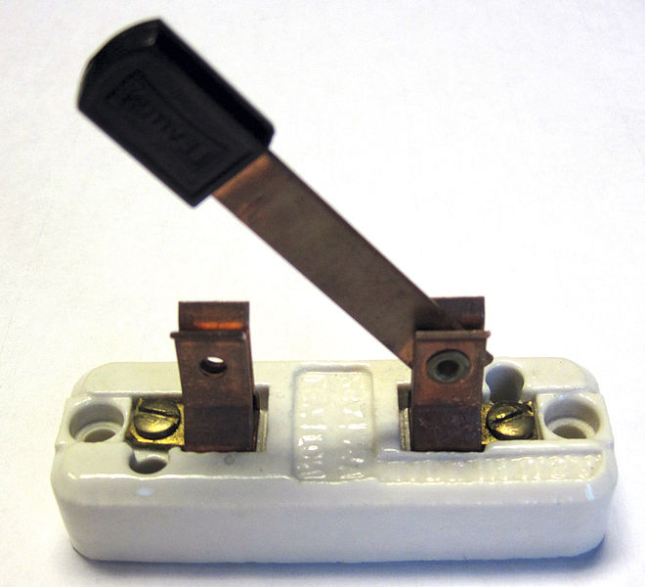
DFX Decouplers
Before changing the functionality of an RP, the connection between the RP and the static region should be temporarily decoupled to avoid glitches.
Static Region
Reconfigurable
Partitions
https://commons.wikimedia.org/wiki/File:Open_knife_switch.jpg

Slide 49
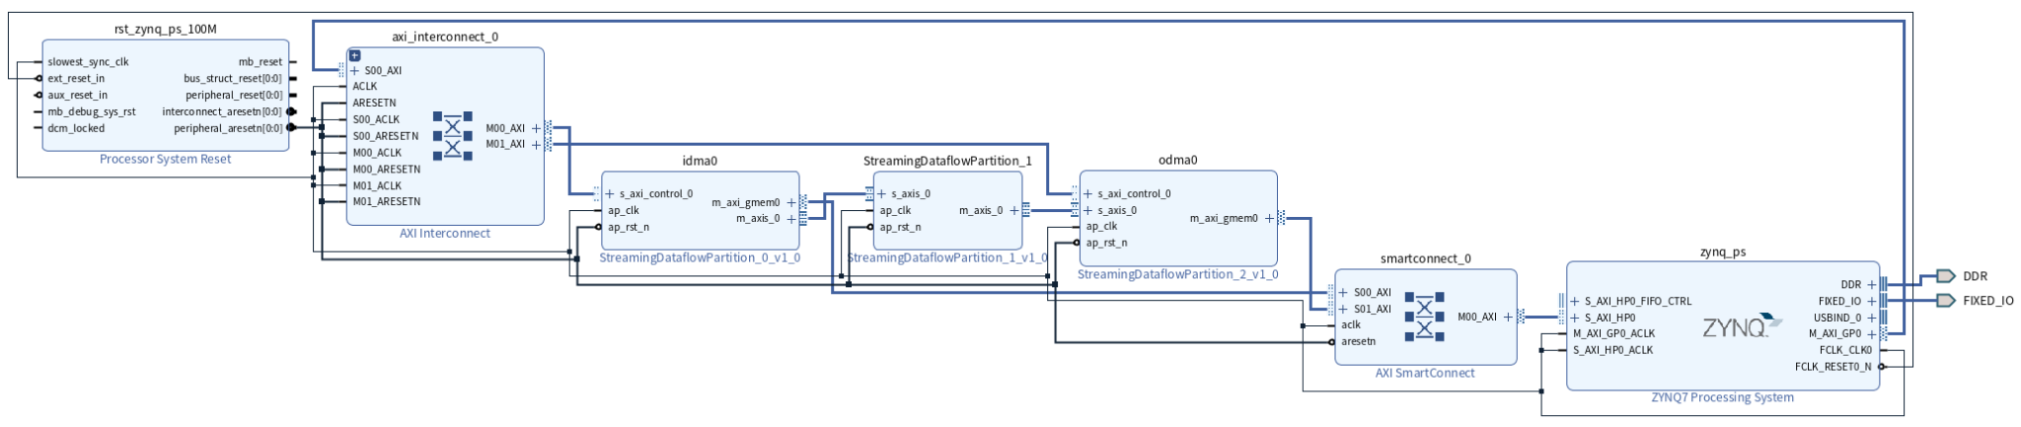
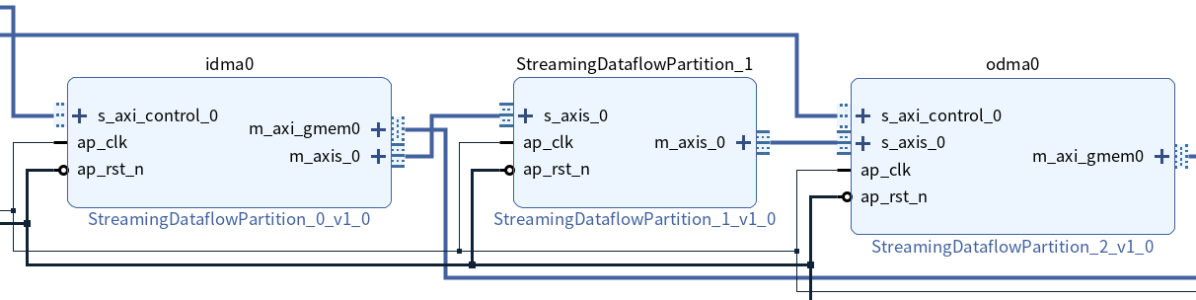
FINN’s Customized IODMA IPs
CNN

Slide 50
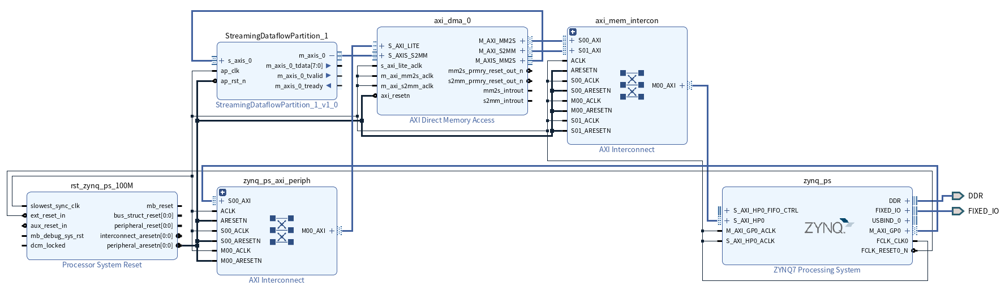
FINN Standalone IP Instantiation
FINN can generate a path-independent IP in DCP (design checkpoint) file format.
AXI DMA IP
(For AXI4-Stream)
CNN IP
model = model.transform(CreateStitchedIP(fpgapart="xc7z020clg400-1", clk_ns=10, vitis=True))

Slide 51
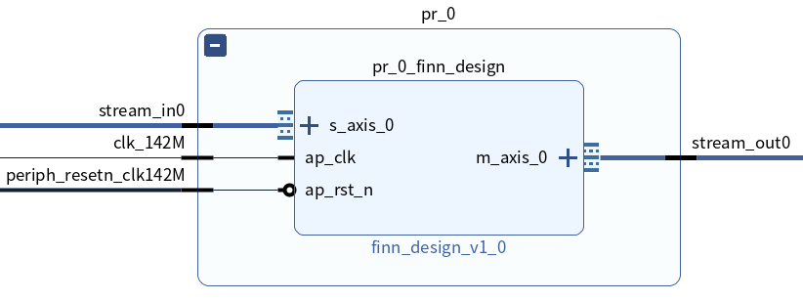
Instantiate FINN IP in DFX
# Create a hierarchical cell that contains the generated FINN IP.
# This hierarchical cell further becomes an Reconfigurable Partition (RP).
create_bd_cell -type hier pr_0

Slide 52
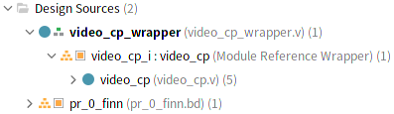
Create Partition Definition (PD) and first associated Reconfigurable Module
# Duplicate the hierarchical cell as another independent Block Diagram design file.
# It appears in the Hierarchy view outside of the top design.
create_bd_design -cell [get_bd_cells /pr_0] pr_0_finn

Slide 53
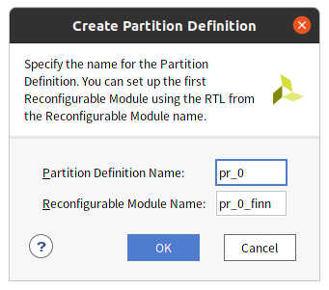
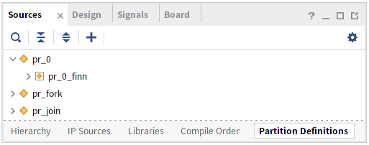
Create Partition Definition (PD)
and first associated Reconfigurable Module
A Partition Definition (PD) defines a set of RMs that are associated with the module instance (or RP).
# Create PD from the duplicated module through either GUI or Tcl command.
# PD appears in the Partition Definitions view along with RM.
set new_pd [create_partition_def -name pr_0 -module pr_0_finn]
create_reconfig_module -name pr_0_finn \
-partition_def $new_pd -define_from pr_0_finn

Slide 54
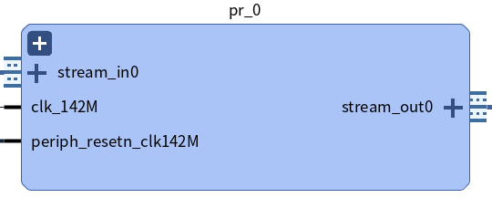
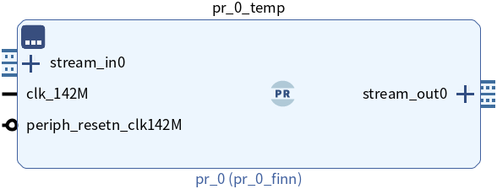
Replace the hierarchical cell with the PD cell
# Set the current design back to the top design that contains the hierarchical cell
current_bd_design [get_bd_designs video_cp]
# Create the PD cell pr_0_temp that references the PD pr_0
set new_pdcell [create_bd_cell -type module -reference $new_pd pr_0_temp]
# Replace the hierarchical cell pr_0 with the created PD cell pr_0_temp
replace_bd_cell [get_bd_cells /pr_0] $new_pdcell
delete_bd_objs [get_bd_cells /pr_0]
set_property name pr_0 $new_pdcell
hierarchical cell
PD cell

Slide 55
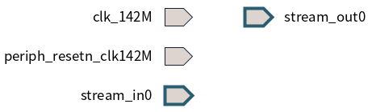
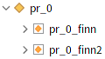
Create other associated RMs
# Create an empty Block Diagram design file that only contains ports.
# The boundary is copied from the first associated RM to avoid port inconsistency.
create_bd_design -boundary_from [get_files pr_0_finn.bd] \
pr_0_finn2
# Move the created RM under the PD.
create_reconfig_module -name pr_0_finn2 \
-partition_def pr_0 -define_from pr_0_finn2
You have to do the design for the other RMs in the created Block Diagram.

Slide 56
Physical Constraints
# Create an Pblock.
create_pblock pblock_pr_0
# Add the PD cell to the Pblock, so the Reconfigurable Partition (RP) resides in the Pblock.
add_cells_to_pblock \
[get_pblocks pblock_pr_0] \
[get_cells -quiet [list video_cp_i/pr_0]]
# Define the shape of the Pblock.
resize_pblock [get_pblocks pblock_pr_0] -add {SLICE_X0Y0:SLICE_X113Y149}
# Set necessary properties.
set_property RESET_AFTER_RECONFIG true [get_pblocks pblock_pr_0]
set_property SNAPPING_MODE ON [get_pblocks pblock_pr_0]
set_property IS_SOFT FALSE [get_pblocks pblock_pr_0]

Slide 57
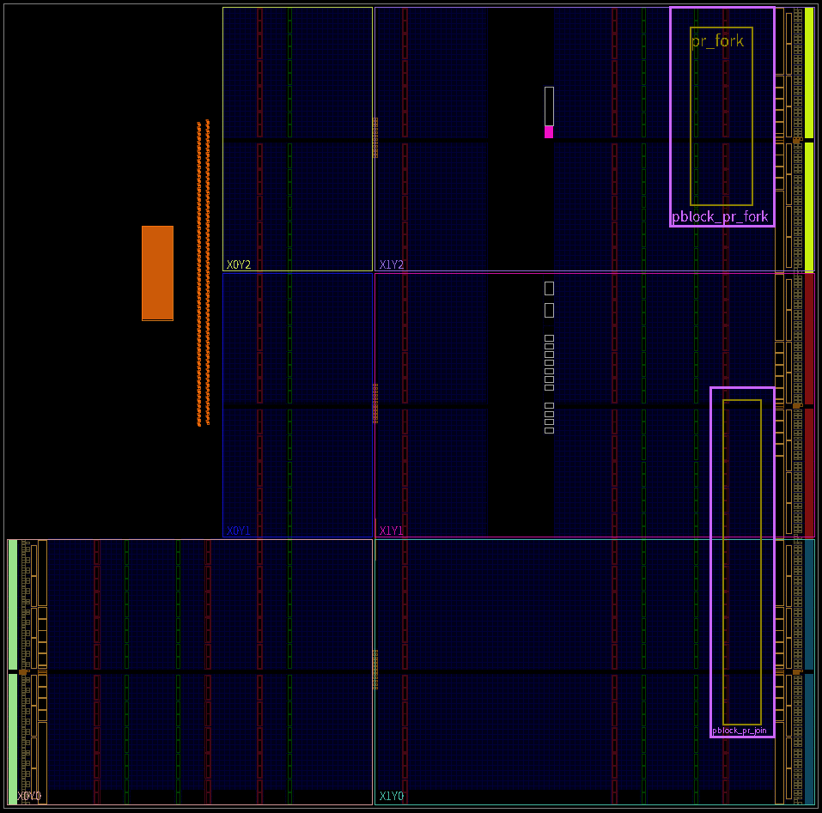
Physical Constraints

Slide 58
GitHub Repository Link
https://github.com/yth98/Xilinx-HLS/tree/master/Preprocess_CNN_Pipeline

